Slide 1
MRI of spinal cord
Dr. Aminur Rahman
FCPS (Med), MD(Neuro) ,FINR (Switzerland), Member ACP (USA)
Fellow Interventional Neuroradiology (Thailand)
Assistant Professor
Department of Neurology
Sir Salimullah Medical College

Slide 2
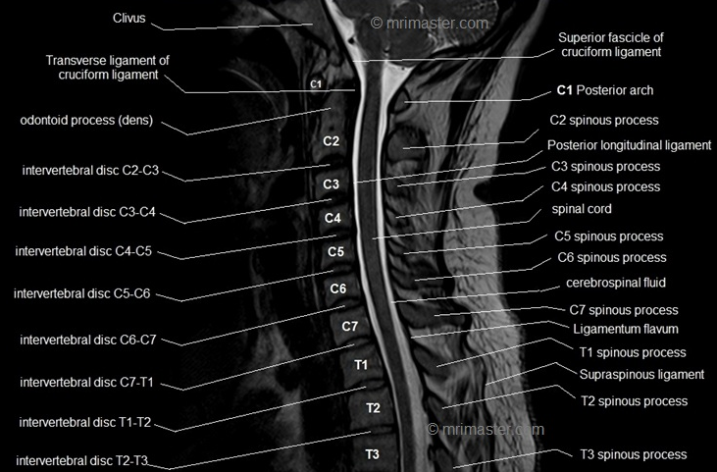
MRI of cervical spine

Slide 3
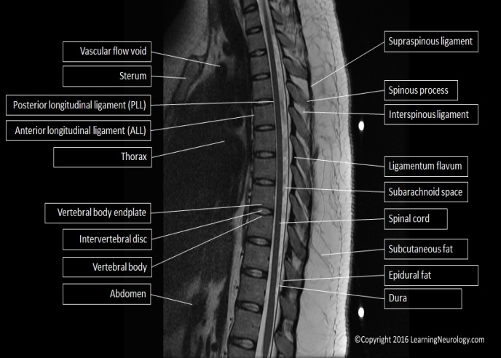
MRI of Dorsal spine

Slide 4
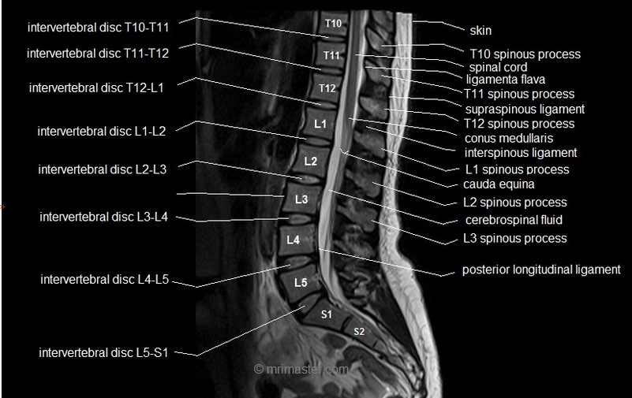
MRI of lumbosacral spine

Slide 5
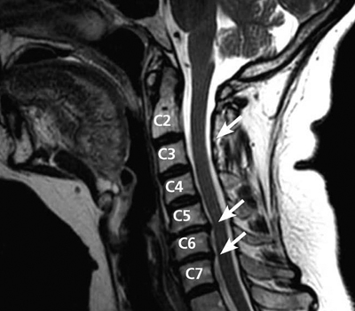
Figure: MRI (side view) shows a disc herniation between the C5 and C6 vertebrae and C6 and C7 indenting upon the thecal sac and ventral aspect of the spinal cord.

Slide 6
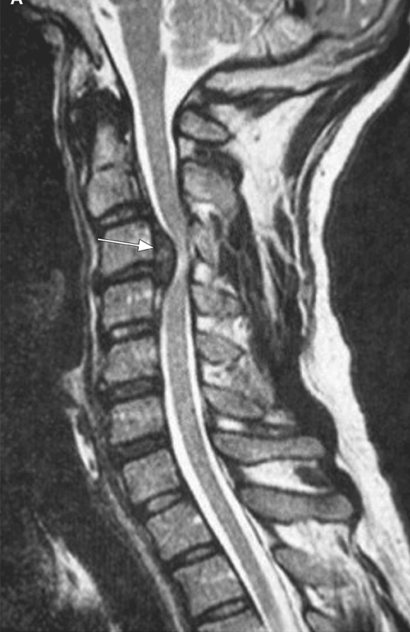
Figure: Sagittal T2-weighted magnetic resonance imaging scan showed bulging C3–C4 disk herniation, with signs of spinal stenosis, severe spinal cord compression (arrow) and spinal cord edema. The C3–C4 disk was almost collapsed.

Slide 7
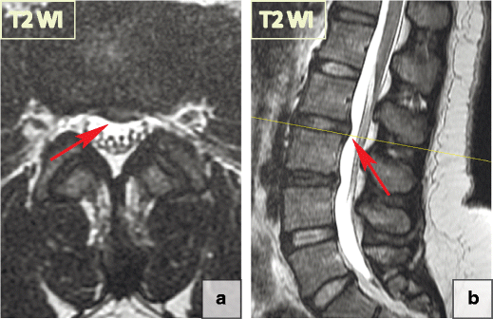
Figure. 35.15 Focal disc displacement: protrusion. T2-WI sagittal and axial MRI of lumbar spine scans demonstrate focal left L2-L3 paracentral posterior protrusion. There is no disruption of the fibres of the overlying annulus fibrosus or the posterior longitudinal ligament.

Slide 8
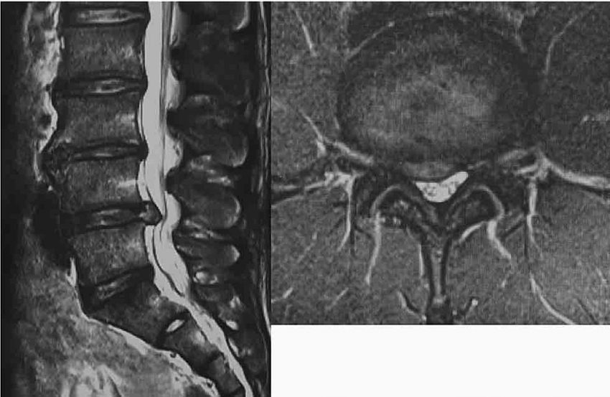
Figure:T2-WI sagittal and axial MRI of lumbar spine at L4/5 level showing the right paracentral disc protrusion at L4/5 level compressing the L5 root.

Slide 9
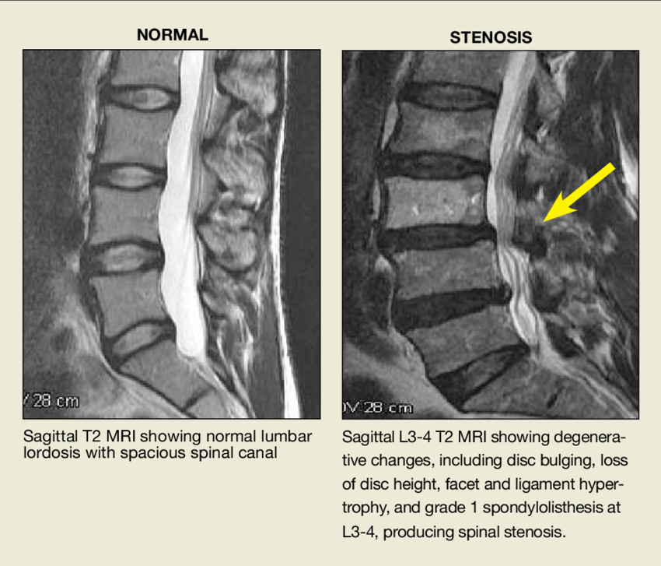
Figure: T2-WI sagittal MRI of lumbar spine showing normal lumber lordosis with spacious spinal canal.T2-WI axial and sagittal MRI of lumbar spine showing degenerative changes, including disc bulging, loss of disc height, facet and ligament hypertrophy and grade 1 spondylolisthesis at L3-4 producing spinal stenosis.

Slide 10
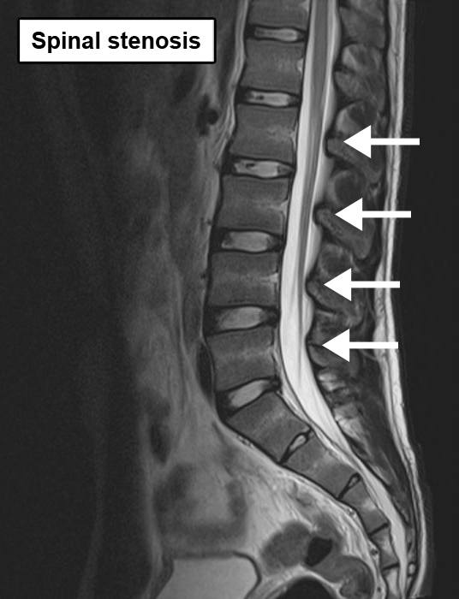
Figure: T2-WI sagittal MRI of lumbar spine showing thickening and folding of ligamentum flavum hypertrophy in the spinal canal producing spinal stenosis.

Slide 11
Box: Short or long spinal segment involvement
Short segment involvement ( 2 segments) common in: MS Degenerative uncommon in: Transverse myelitis - partial form Long segment involvement common in: Transverse myelitis - complete form Neuromyelitis Optica uncommon in: MS Degenerative

Slide 12
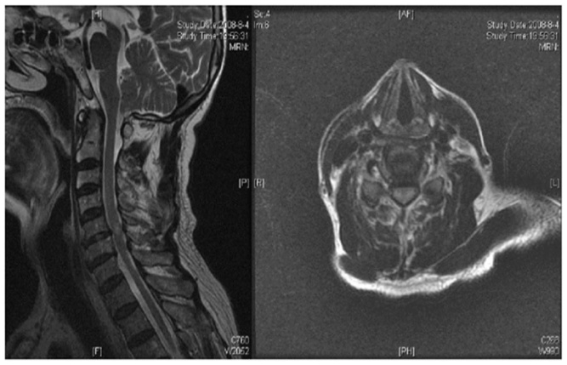
Figure; T2-WI axial and sagittal MRI of cervical spine demonstrate disc herniation at the C5–6 level and high signal changes in the spinal cord and myelopathy.

Slide 13
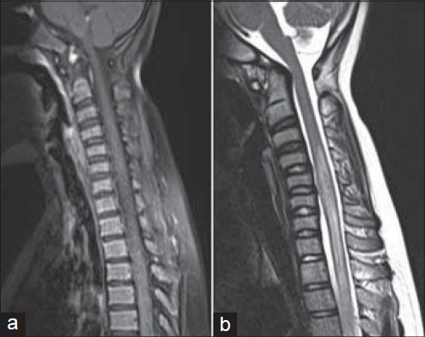
Figure 37.6: Magnetic resonance imaging of spinal cord (sagittal view) showing normal spinal cord in T1-weighted image (a) and hyperintensity within the cord adjoining C-5 to D-4 vertebrae in T2-weighted image (b), suggesting long segment acute transverse myelitis.

Slide 14
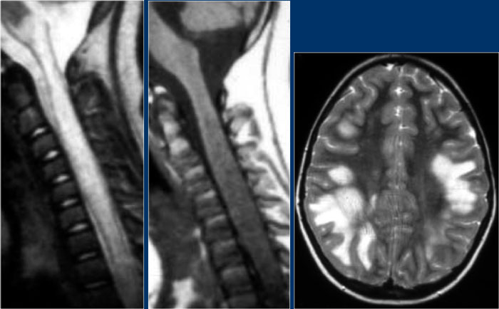
Figure:T2-WI sagittal MRI of cervical spine demonstrate diffuse involvement of the spinal cord extending from C1 to C7 (between arrows) and mildly expanding the cord. The lesion is isointense on the T1WI and in T1+Gd (contrast) nonenhanced. Again there is also involvement is involvement of the brain suggesting ADEM.

Slide 15
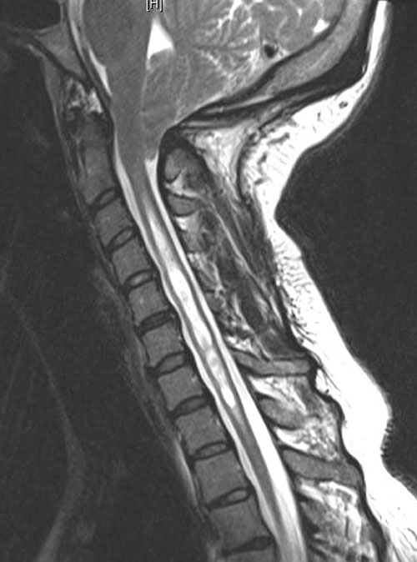
Figure: Sagittal T2-weighted MR images demonstrate significant multi-compartmental syringomyelia at the C2- T1 the spinal cord.

Slide 16
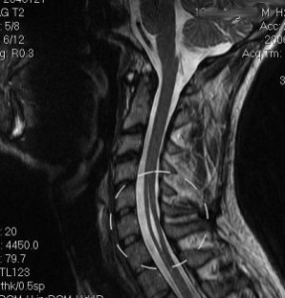
Figure: Sagittal T2-weighted MR images demonstrate a significant syrinx in the C4-6 cervical spinal cord.

Slide 17
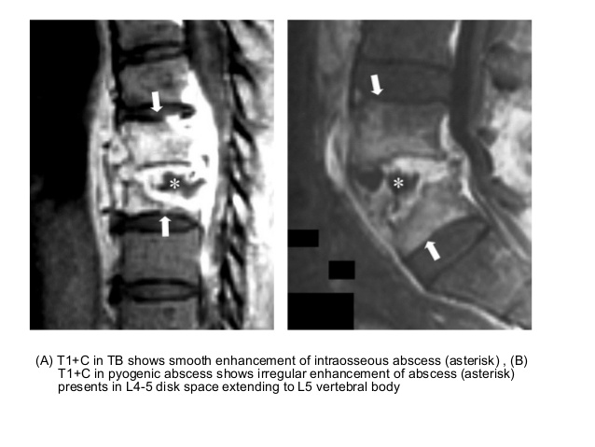
Figure: 39.1 (Right) Sagittal T1+C MR image shows smooth enhancement of intraosseous abscess (asterisk). (Left) Sagittal T1+C MR image in pyogenic abscess shows irregular enhancement of abscess (asterisk) presents in L4-5 disk space extending to L5 vertebral body. My radiological diagnosis is tuberculous spondylitis.

Slide 18
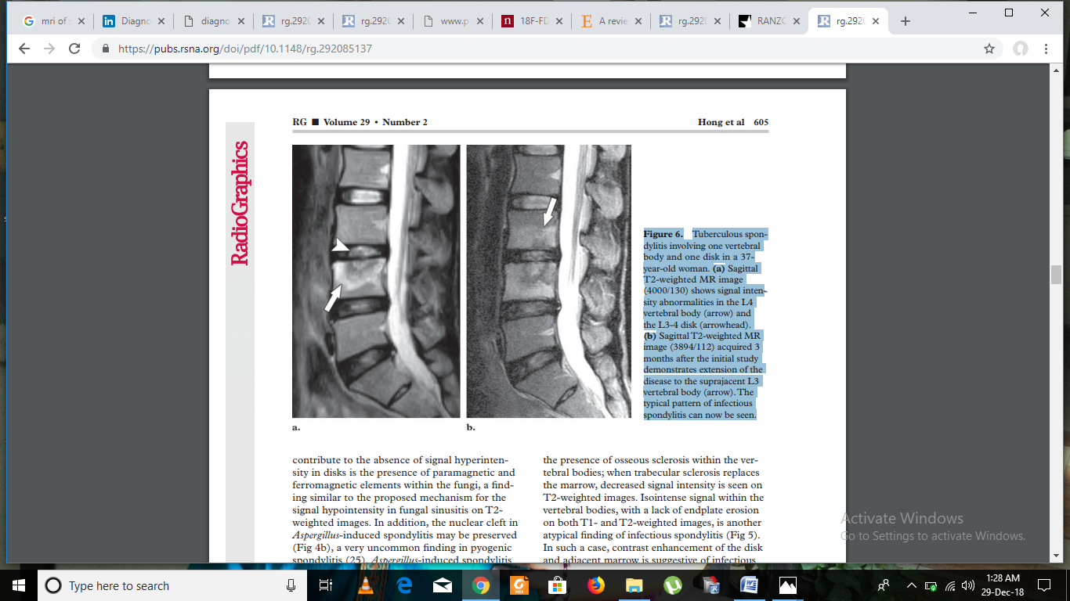
Figure (a) Sagittal T2-weighted MR image shows signal intensity abnormalities in the L4 vertebral body (arrow) and the L3-4 disk (arrowhead). (b) Sagittal T2-weighted MR image (3894/112) acquired 3 months after the initial study demonstrates extension of the disease to the suprajacent L3 vertebral body (arrow). The typical pattern of infectious spondylitis can now be seen.

Slide 19
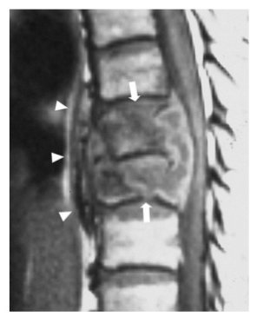
Figure: T1 shows heterogeneously hypointense signal (arrows) in T8-T9 vertebral bodies with epidural mass and subligamentous spread (arrowheads) from T7 to T10. My radiological diagnosis is Tuberculous spondylitis

Slide 20
Box: Typical radiological features for MS in the spinal cord
There are multiple lesions in the spinal cord. Typical spinal cord lesions in MS are relatively small and peripherally located. They are most often found in the cervical cord and are usually less than 2 vertebral segments in length In the cord there are some well-defined lesions, but also some ill-defined foggy lesions. The transverse image shows the dorsal location and the typical triangular shape. Continue with the contrast-enhanced image Proton density weighted image (PDWI) is crucial for studying the spinal cord. On PDW-images the spinal cord has a uniformly low signal intensity (like CSF), which gives the MS lesions a good contrast against the surrounding CSF and normal cord tissue.

Slide 21
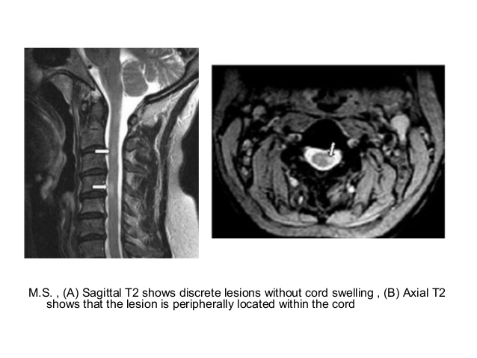
Figure: (Right ) Sagittal T2 shows discrete lesions without cord swelling (between arrows), (left) On an axial T2-weighted image a triangular shape and are located laterally (arrow head) is involved and shows a hyperintense signal suggesting MS.

Slide 22
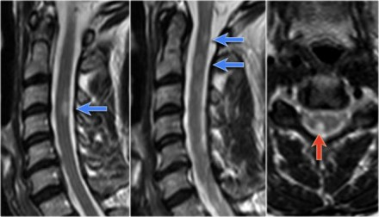
Figure: 40.8 T2-WI sagittal MRI of cervical spine demonstrate extending from mid-c2 to mid-c3 (between arrows) and mildly expanding the cord (a). The demyelinating lesion is hyperintense on the contrast enhanced sagittal T1-weighted image (b). On an axial T2-weighted image at the mid-C2 level round or triangular shape and are located posteriorly or laterally is involved and shows a hyperintense signal (c) suggesting MS

Slide 23
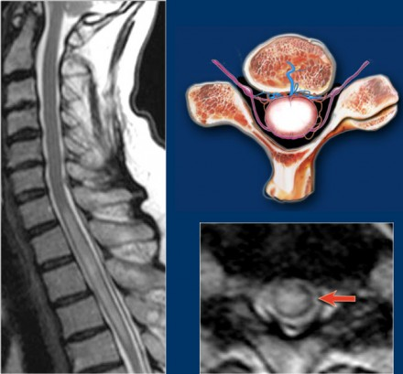
Figure: T2-WI sagittal MRI of cervical spine demonstrate extending from lower-C6 to mid-D3 (between arrows) and mildly expanding the cord (a). (b). On an axial T2-weighted image at the D1 level most of the cord is involved and shows a hyperintense signal suggesting TM

Slide 24
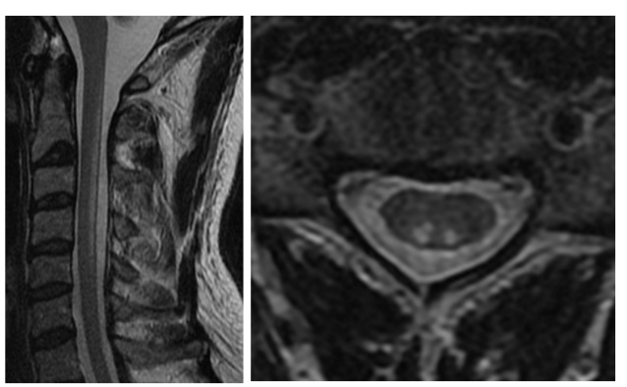
Figure: 40.13 T2 shows hyperintensity (arrows) in the dorsal aspect of the cord spinal extending from the level of C2 to the level of C5. Axial T2 obtained through the cervical spinal cord at three separate levels from C3 to C4 show bilateral symmetric signal intensity abnormality within the dorsal columns (arrows-Inverted V sign) So my radiological diagnosis is Subacute Combined Degeneration

Slide 25
Spinal cord tumour
Extradural (Epidural) Tumors:
Epidural tumors are usually from metastatic involvement of vertebral bodies.
Lung cancer, breast carcinoma, thyroid carcinoma, renal cell carcinoma are common sites of primary that metastasize to vertebral bodies.
Primary vertebral body tumors (less common): Osteoma, Osteogenic sarcoma, Chondroma, Chondrosarcoma and Chordoma.

Slide 26
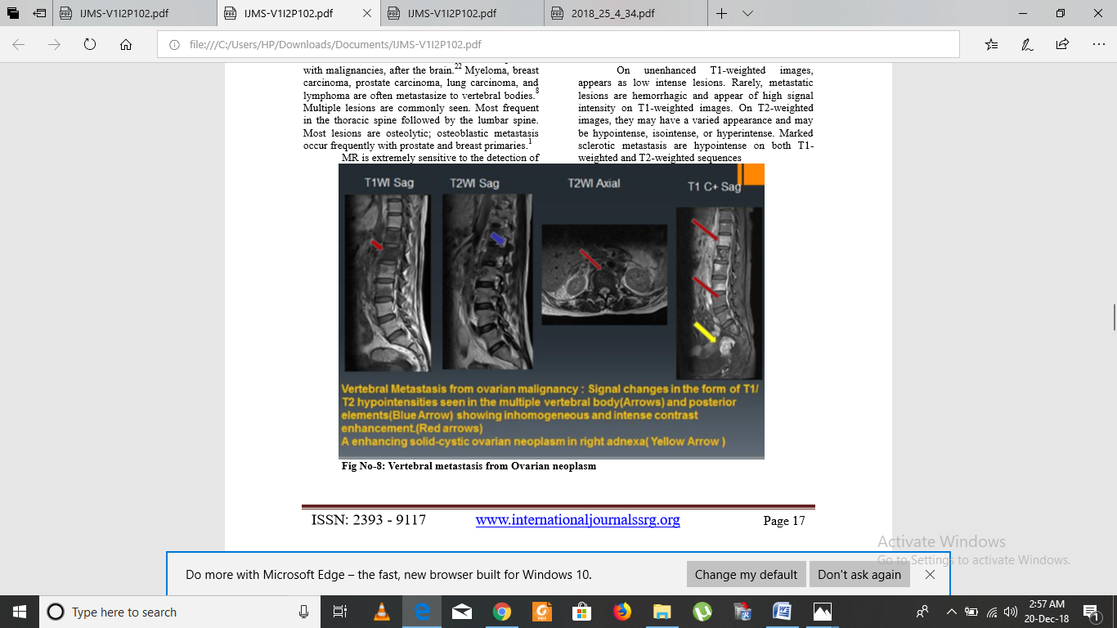
Figure: 41.7MRI of lumbosacral spine shows
Non - contrast sagittal T1W and sagittal & axial T2 W MRI
Shows hypointensities of multiple vertebral body (arrows) and posterior element (blue arrow) lesion which linear oval intradural, extramedullary mass is extending from C6–T3.
Post contrast Sagittal T1 W MRI
Shows an inhomogenous intense contrast enhancement (Red arrow) hyperintense lesion. An enhancing solid-cystic ovarian neoplasm in the right adenexa ( yellow arrow)
So my radiological diagnosis is vertebral metastasis from ovarian malignancy

Slide 27
Intradural Extramedullary Tumors:
Meningioma and schwannoma are common intradural extramedullary tumors.
Nerve sheath tumors are pathologically classified as neurofibroma or schwannoma.

Slide 28
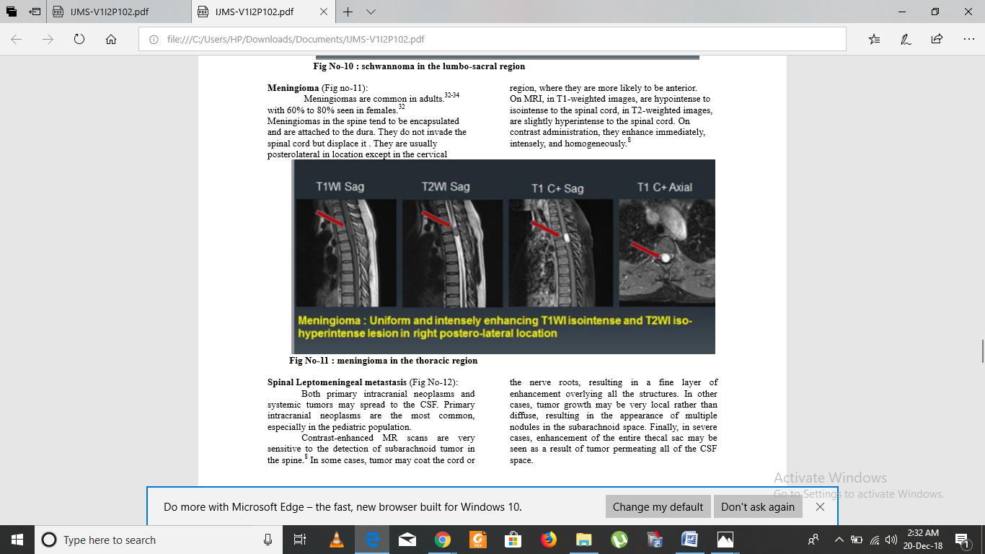
An intradural extramedullary enhancing tumor. Ventrally located tumor has produced cord compression with displacement of the right postero-lateral location of the thoracic cord. So my radiological diagnosis is meningioma.

Slide 29
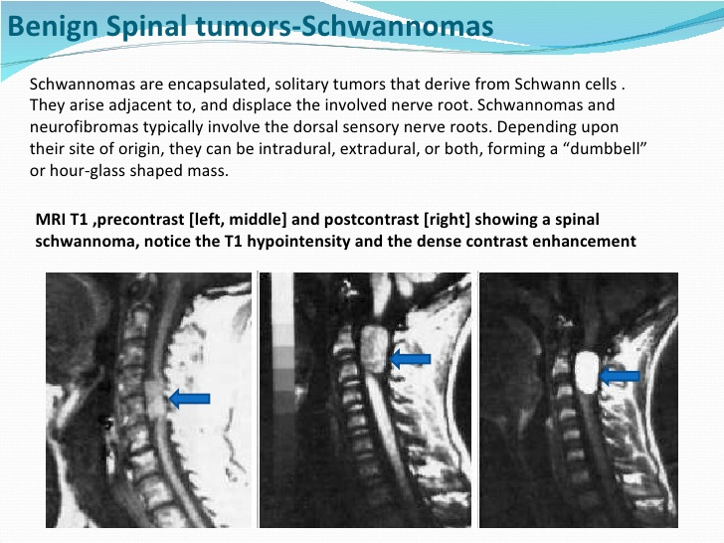
Intraspinal component producing cord compression and paraspinal tumor extension through an enlarged neural foramen following the exiting nerve root. This is characteristic of nerve sheath tumor. An enhancing intradural extramedullary nerve sheath tumor. So my radiological diagnosis is schwannoma.

Slide 30
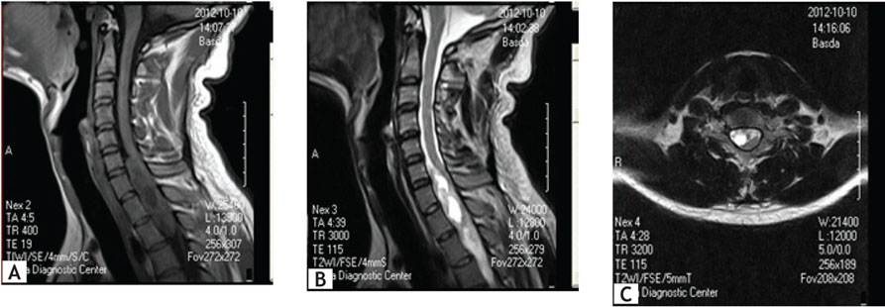
schwanoma

Slide 31
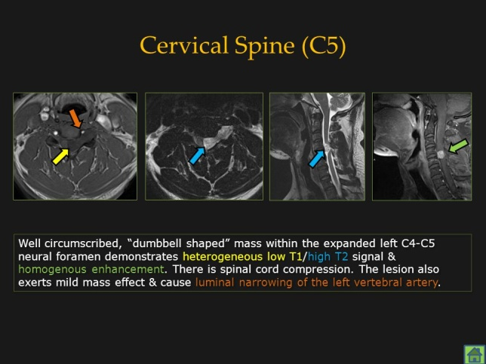
Dumbbell shape of tumor with intraspinal component producing cord compression and paraspinal tumor extension through an enlarged neural foramen following the exiting nerve root. This is characteristic of nerve sheath tumor. An enhancing intradural extramedullary nerve sheath tumor. So my radiological diagnosis is schwannoma.

Slide 32
Intradural Intramedullary Spinal Cord Tumors
Intradural Intramedullary tumors are Ependymomas, Astrocytoma, Hemangioblastoma and Metastasis.
Intraspinal cord tumors are classified as intramedullary when they originate from the spinal cord itself.
Ependymoma and astrocytoma are common intramedullary tumors.
In intramedullary tumors, the cord expands both in sagittal and axial projections

Slide 33
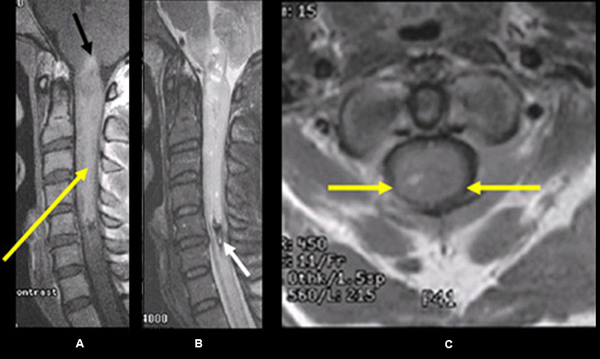
This is intramedullary tumor because the cord has expanded in both sagittal and axial projections.It is centrally located.Intensely enhancing tumor. So my radiological diagnosis is ependymoma.

Slide 34
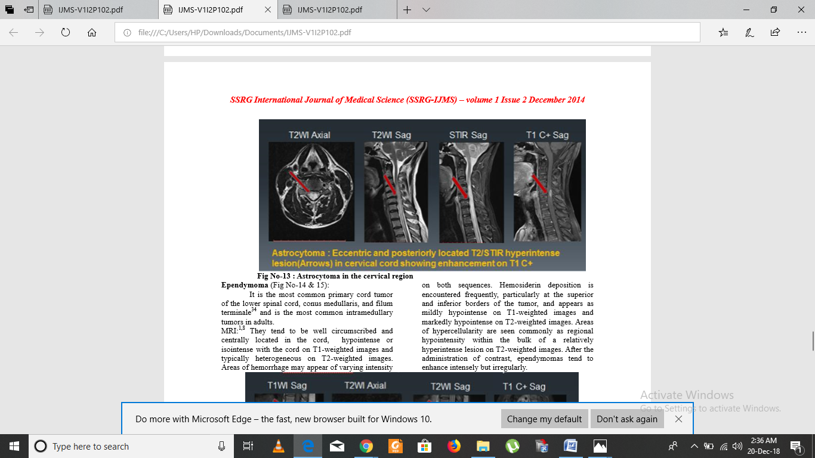
Figure: MRI of cervical spine showing axial & Sagittal T2 and STIR images Shows homogenous hyperintensity(red arrow) mass lesion situated eccentric and posteriorly of spinal cord .Post-contrast axial T1wtd. MRI (C+). The same lesion with enhancement. So my radiological diagnosis is Astrocytoma

Slide 35
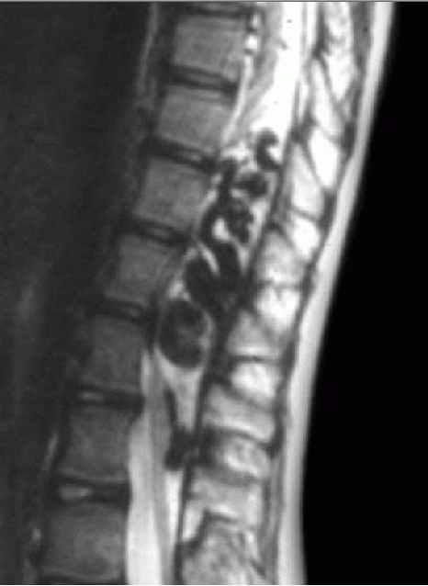
Figure: Midsagittal T2WI shows multiple dilated blood vessels in and outside of the distal spinal cord. Fast flow in these vessels results in their signal void. My radiological diagnosis is spinal cord arteriovenous malformations

Slide 36
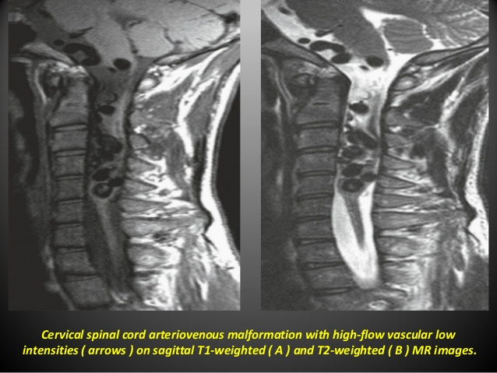
Figure: 42.12 Midsagittal T1W (Right) &T2WI (left ) cervical MRI shows multiple dilated blood vessels in and outside of the Cervical spinal cord. Fast flow in these vessels results in their signal void (low intensities) . My radiological diagnosis is Cervical spinal cord arteriovenous malformation

Slide 37
Thank you

